Slide 1

Minor Project - 2
Title: Online Voting System
Presented by:
R103219018 - Shivani Saran
R103219028 - Utkarsh Sharma
R103219010 - Luxmi Rana
R103219027 - Chirag Raghuwanshi
Mentored By:
Mr. Bikram Pratim Bhuyan
Assistant Professor

Slide 2
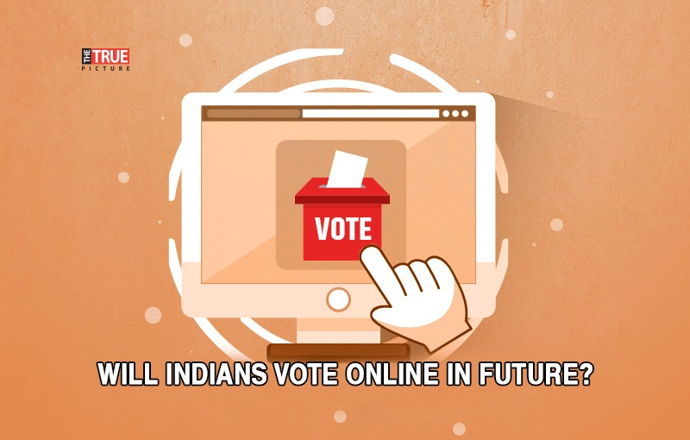
Content
Introduction
Literature Review
Timeline
Objectives
Methodology
Working Model
Interface
Admin
Voter
Snapshots
Results
Limitations
Conclusion
References

Slide 3

Introduction
The word “vote” means to choose from a list , to elect or to determine. The main goal of voting is to come up with leaders of the people’s choice.
Online Voting System is a voting system by which any Voter can use his/her voting rights from anywhere in the country.
In this system people who have citizenship of India and whose age is above 18 can give their vote through online without going to any physical polling station.
The voter is assigned a secret username and password with which he/she can use to log into the system and vote .

Slide 4
PROBLEM STATEMENT
The voting/polling process by registered voters is very cumbersome. So many cases of missing data in the voter registration files have been reported. There are also scenarios where unregistered voters flock in the polling centers as "Dead Voters" to participate in the voting process. The voters can vote from anywhere around the globe, they don't need to travel back during election time in case they are abroad using online voting system.

Slide 5

MOTIVATION
Online voting is a good option as it allows :
Vote at any time from anywhere
Boost participation
Less physical infrastructure
More rich ballots
Fast and easy votes tally

Slide 6
Literature Review
[1] The online voting system is highly secured, and it’s design is very simple, ease of use and also reliable.
[1] Various drawbacks such as Time consuming , Consumes large volume of pare work , No direct role for the higher officials, Damage of machines due to lack of attention, Mass update doesn’t allows users to update and edit many item simultaneously. These drawbacks are overcome by Online Voting System.
[2] Our intent is not to propose a particular online voting solution, but rather to provide input to a future gov- ernment committee or task force that may be created to delve further into the topic.
[3] In the proposed system the tallying of the votes will be done automatically, thus saving a huge time and enabling Election Commissioner of India to announce the result within a very short period.

Slide 7

SWOT Analysis
Strengths:-
1. Voting in any language convenient to the voter.
2. Online voting eliminates queue during voters’ registration and voting.
3. It will also help in saving time and paperwork.
Weaknesses:-
1. Lack or pressure group in support of online voting system
2. Technology acceptance
Opportunities:-
1. Increase in number of voters
2. Social distance is supported
Threats:-
1. Security issues
2. Data breach
3. Political threats

Slide 8
Plan of Work
TASKS | FEBRUARY | MARCH | APRIL | MAY
Group Formation
Research
Structure and Planning
Code Formation
Testing
Documentation

Slide 9
Objective
Main objective :
To increase efficiency and percentage of voting for the common people.
It reduces the time spend making long queues at the polling stations during voting. It also enable the voters to vote from any part of the globe .
Sub objective :
Choosing online voting system avoid human counting errors.
With the power of linking , image rendering , online voting system gives the chance to add additional information to the ballots

Slide 10
Methodology
With the "ONLINE VOTING SYSTEM", a voter can use his/her voting right online without any difficulty.
He/she has to register as a voter first before being authorized to vote. The registration should be done prior to the voting date to enable data update in the database.
However, not just anybody can vote. For one to participate in the elections, he/she must have the requirements. For instance, he/she must be a registered citizen i.e. must be 18 and above years old.
As already stated, the project ‘Online Voting' provides means for fast and convenient voting and access to this system is limited only to registered voters.

Slide 11
The project have following major features:
Admin module:
Voter module :
Candidate module :

Slide 12
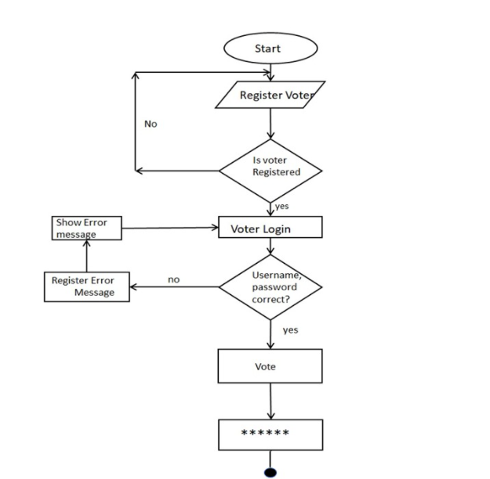
Working Model
Technical Diagram :

Slide 13
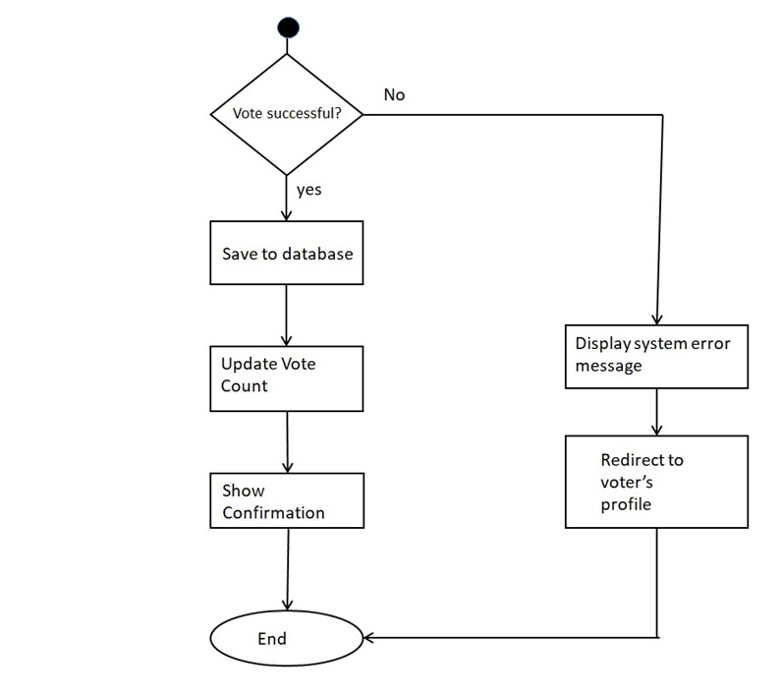

Slide 14
INTERFACE
VOTER
REGISTER
LOGIN
ADMIN
REGISTRATION
LOGIN
ADMIN
VOTER
CONTACT
UPDATES
LOGOUT
CONTACT US
BY EMAIL
BY MOBILE NO
BY TWITTER
BY POST
Back/logout
Updates about new Election
CANDIDATES
PLACE OF ELECTION
DATE OF VOTING
TIME OF VOTING
Back/logout

Slide 15
ADMIN
REGISTRATION FORM
Name
Gender
National Identity no
Password
City Province
E-mail
Mobile no
Do you want to Login
You are Registered
Yes || No || Cancel
REGISTRATION
LOGIN
Yes
Manage Candidate
View Results
Main Page
Logout
LOGIN
Login Successful
Username
National Identity
Password

Slide 16
VOTER
Registration Form
Voter Id
Name
E mail
Mobile Phone
Username
Password
Address
LOGIN
MAIN MENU LOGOUT
REGISTRATION
LOGIN
Login
Caste Vote
LOGIN
Username
Password
Voter ID
Logout||Back

Slide 17
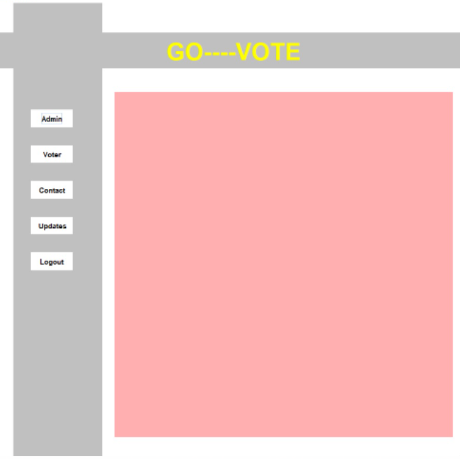
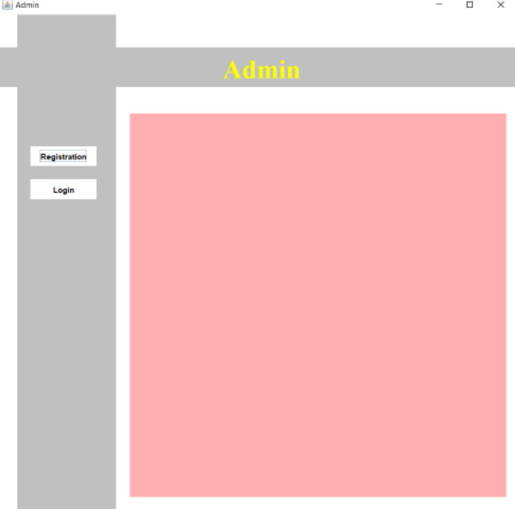
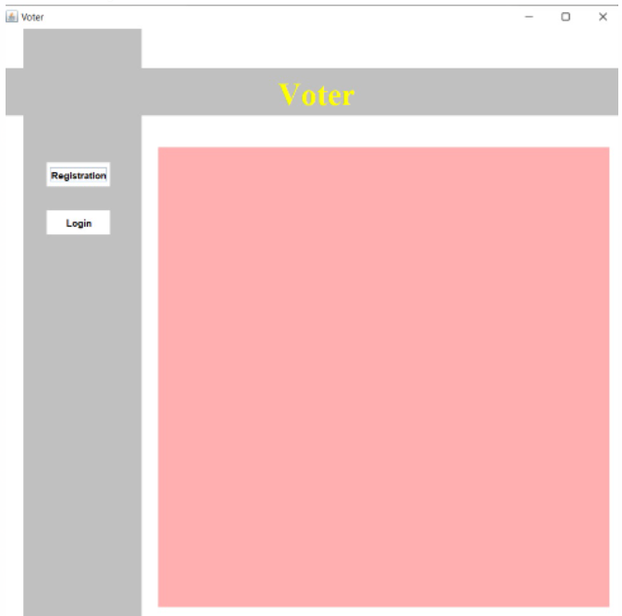
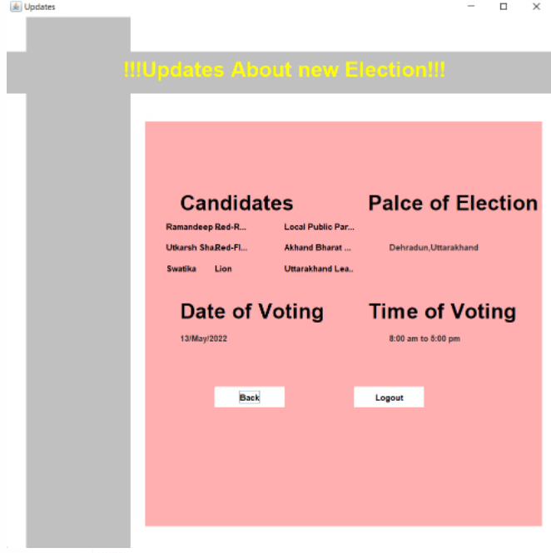
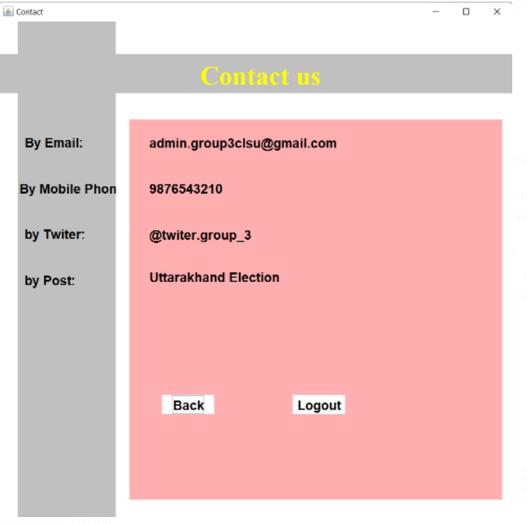
Snapshots

Slide 18
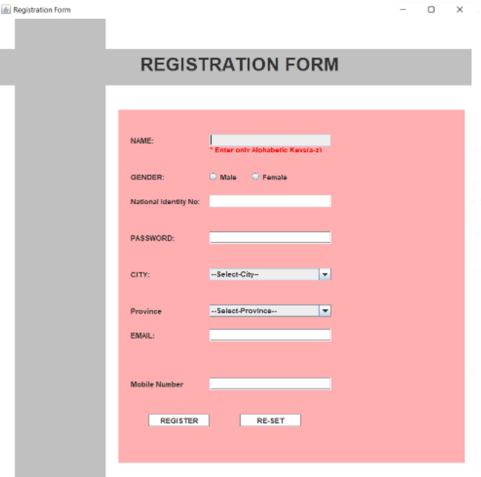
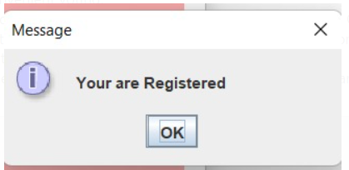
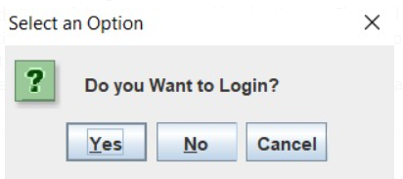
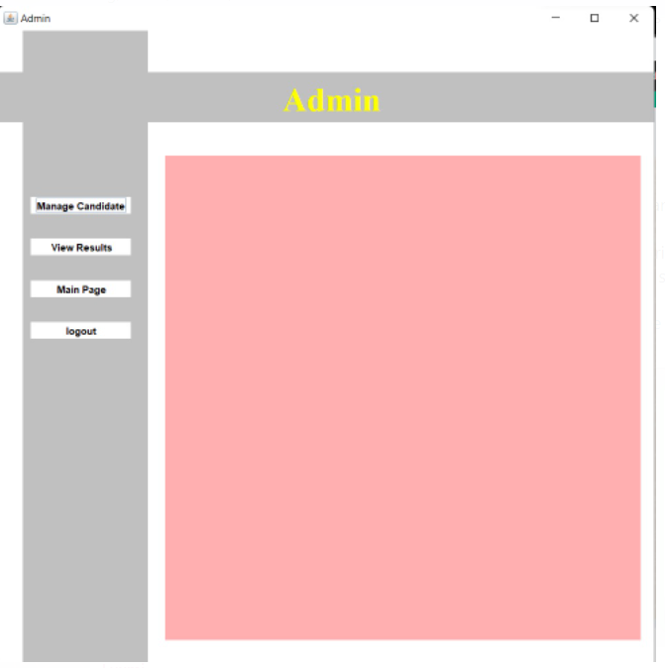
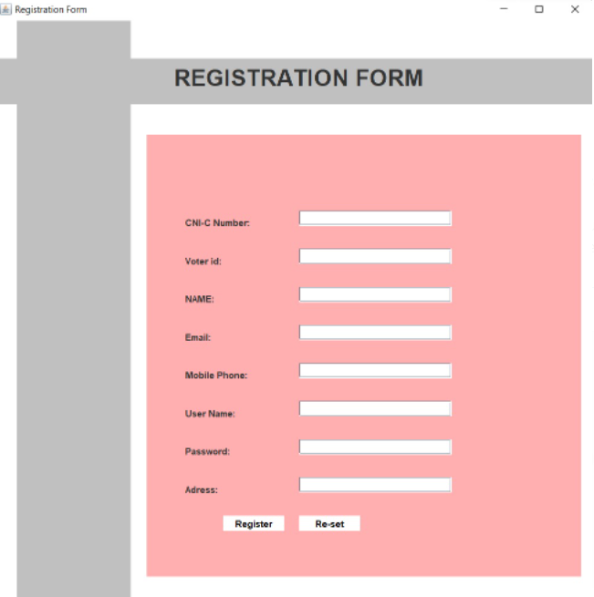
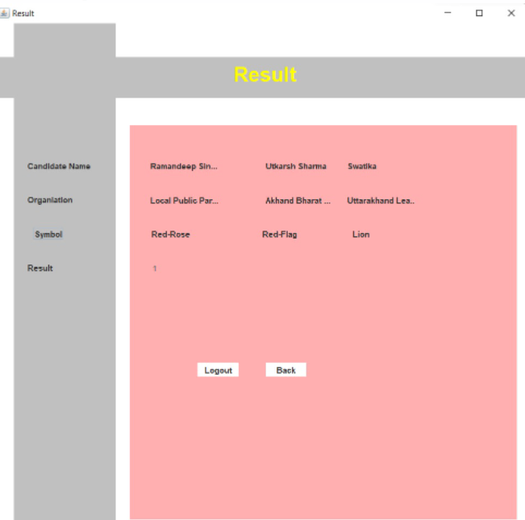
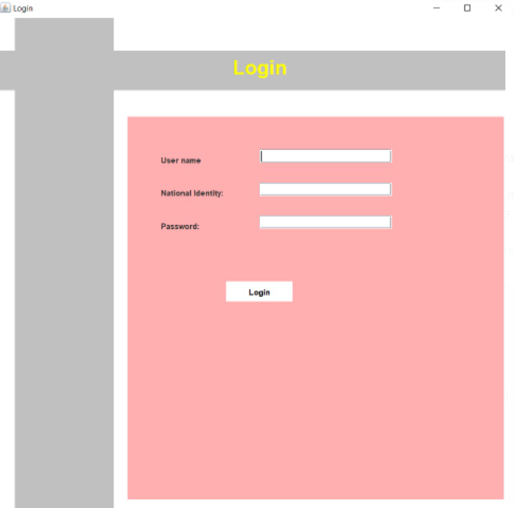
Admin

Slide 19
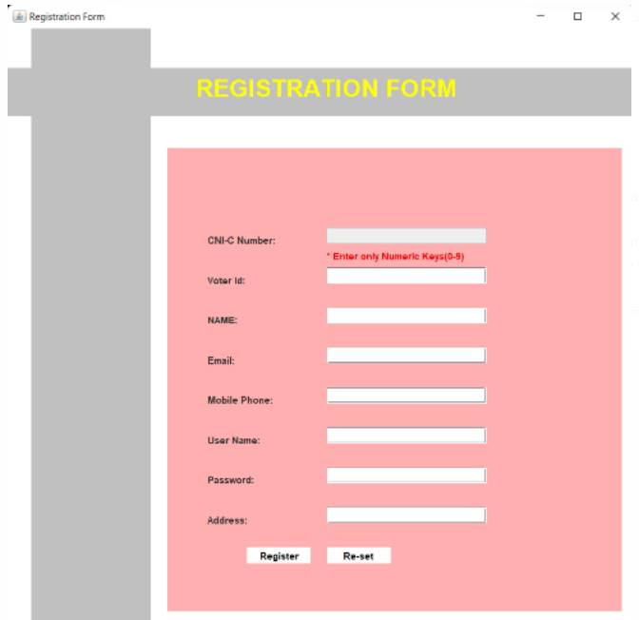


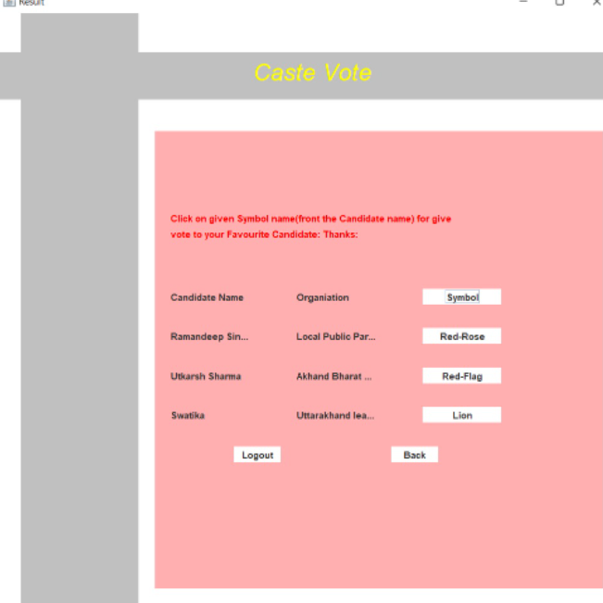
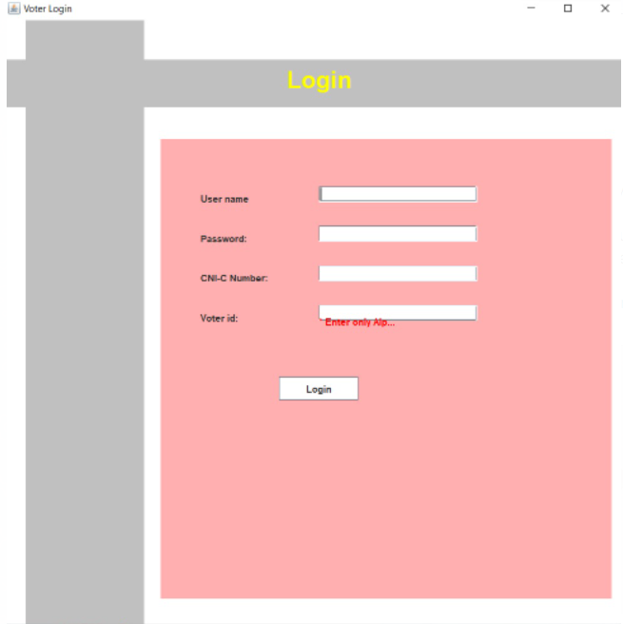
Voter

Slide 20
Results
After running a vote, most online voting software will make it easy to see who or what won out across all the options. Detailed, custom reports are important to many organizations.
These show trends like vote turnout, broken down by department, demographics, or region are helpful for understanding the results of your votes and elections at a deeper level.

Slide 21
Limitations
Lack of devices, internet
Poor connectivity in remote area
Lack of technical awareness

Slide 22
Conclusion
This Online Voting system will manage the Voter's information by which voter can login and use his voting rights.
There is a DATABASE which is maintained by the ELECTION COMMISION OF INDIA in which all the names of voter with complete information is stored.
Voting detail store in database and the result is displayed by calculation.
By online voting system percentage of voting is increases.

Slide 23
Reference
[1] Anand A, Divya P. An efficient online voting system. International Journal of Modern Engineering Research. 2012 Jul;2(4):2631-4.
[2] Kaliyamurthie KP, Udayakumar R, Parameswari D, Mugunthan SN. Highly secured online voting system over network. Indian Journal of Science and Technology. 2013 May;6(6):4831-6.
[3] Agarwal H, Pandey GN. Online voting system for India. In2013 Eleventh International Conference on ICT and Knowledge Engineering 2013 Nov 20 (pp. 1-4). IEEE.
[4] Usmani ZA, Patanwala K, Panigrahi M, Nair A. Multi-purpose platform independent online voting system. In2017 International Conference on Innovations in Information, Embedded and Communication Systems (ICIIECS) 2017 Mar 17 (pp. 1-5). IEEE.

Slide 24
Thank You

